Slide 1
Capstone: Fake News Classification
By Andrew Chia

Slide 2
Table of Contents
01
Background & Problem Statement
02
Exploratory Data Analysis
03
Modelling & Evaluation
04
Conclusion & Recommendations

Slide 3
01
Background & Problem Statement

Slide 4
Fake News
What?
Fake News: false or misleading information presented as news.
Damage the reputation of a person or entity or making money through advertising revenue.
Why?
How Severe is the Problem?
2.8B
USD $78B
Of social media engagement among top 100 news sources are fake
Estimated global economic cost of fake news in year 2019

Slide 5
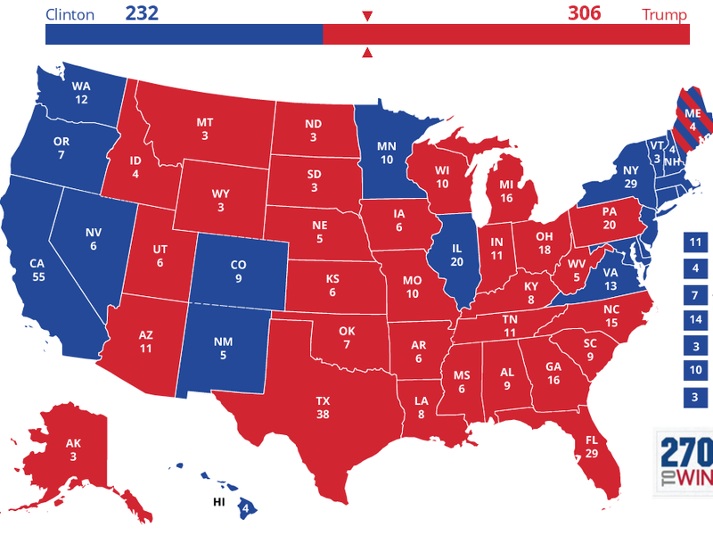
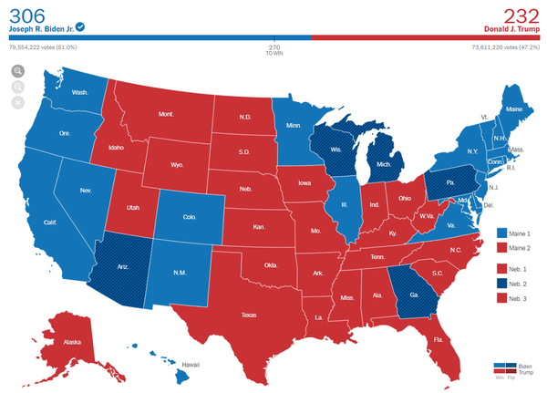
Fake News in US
Fake News in US are mainly political in nature.
2016 Presidential Election
- Fake News became a “buzzword”.
Studies suggest that fake news play an important role in Donald Trump’s win.
Some examples of fake news:
Hillary Clinton approved weapons sales to ISIS
Hillary Clinton was in “very poor health condition”.
2020 Presidential Election
- Multiple fake news being generated to portray that the election was fraud and was stolen from Republicans and Donald Trump.
Some examples of fake news:
Burning of ballot boxes with votes belonging to Trump.
Claims that dead people went voting.

Slide 6


Effects of Fake News in US

Slide 7
Problem Statement
“ This projects aim to use data science methods (classification modellings) to predict whether a news article is fake or real, with prediction having the higher the accuracy, F1 and AUC Score the better (as close to 1 as possible), so as to enable US citizens to have a better capability to differentiate between fake or real news, by allowing them to do it themselves“.

Slide 8
Workflow Outline
Cleaning and Preprocessing of Data
Modelling and Evaluations
Step 1
Step 2
Step 3
Step 4
Step 5
Obtaining the Dataset
Exploratory Data Analysis (EDA)
Insights and Recommendations

Slide 9
Dataset Used
Main Dataset
Records the title and text of the news articles in US
Around 25,000 entries of articles
Time range: Around the US 2016 Presidential Election
70%
30%
Train
Test

Slide 10

Data Cleaning / Data Pre-processing
Data Cleaning
Natural Language Processing Techniques
Vectorization
Imputation of null values with “-” to keep the other columns info
Remove duplicate entries
Removing punctuations
Tokenizing
Remove stopwords
Done lemmatization (more accurate compared to stemming)
Count Vectorization
TF-IDF Vectorization

Slide 11
02
Exploratory Data Analysis

Slide 12
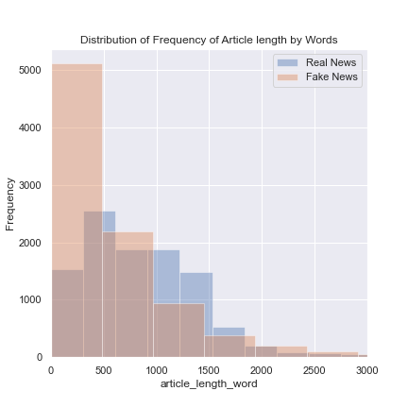
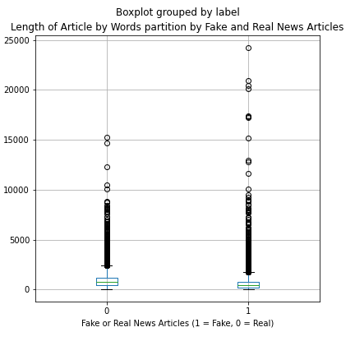
Length of News Articles By Words
There are a few more fake news articles having > 10,000 words.
However, based on distribution, a lot more fake news articles have 0-500 words compared to real news.
Most of real/fake news articles have length of < 2,000 words.
(Real News)
(Fake News)
2
1
3

Slide 13
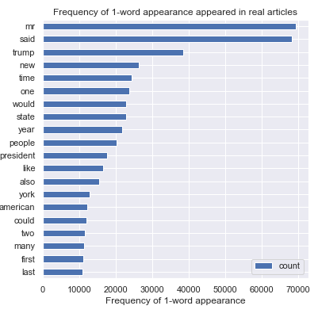
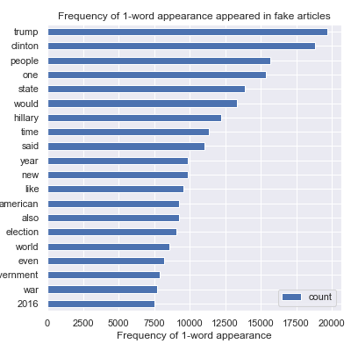
Frequently Appeared 1-Word
Using N-Gram, below are top-20 1-word that appears frequently in both real and fake news articles.
Not much insight could be gathered here except that the words appeared in both shown that these articles are very related to 2016 US Presidential Election with following words:
Real Articles
Fake Articles

Slide 14
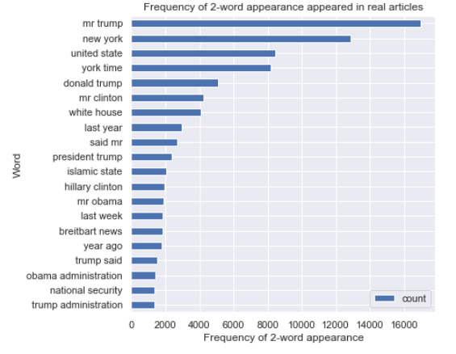
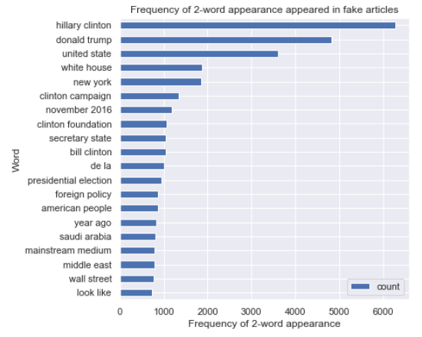
Frequently Appeared 2-Words
Using N-Gram, below are top-20 2-words that appear frequently in both real and fake news articles.
A lot of the 2-words combination appear in both the real and fake news articles. Hence, unable to use the word frequency to properly classify fake or real news.
However, can observe that a lot of fake articles are targeting on Hillary Clinton or Middle East foreign policy.
1
2
Real Articles
Fake Articles
1
2

Slide 15
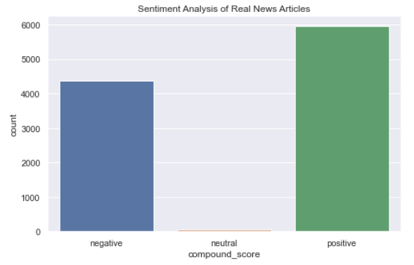
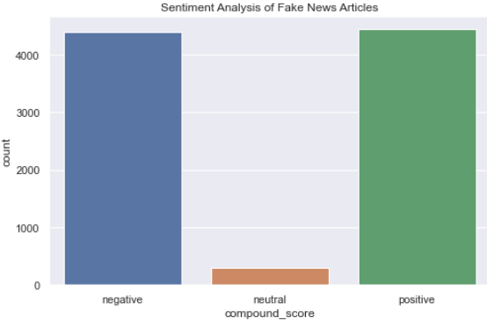
Sentiment Analysis of News Articles
Using Sentiment Analysis Compound Score, below are sentiment of both real and fake articles.
Compound Score < (-0.05): Negative Sentiment, -0.05 to 0.05: Neutral, > 0.05: Positive Sentiment
Within the real news articles, the proportion of positive to negative is around 60:40, which is more positive than the fake news articles with proportion of around 50:50.
However, the sentiment is not too binary (real == +ve, fake == -ve), hence sentiment analysis is not a good way to classify fake/real news.
Real Articles
Fake Articles

Slide 16
03
Modelling & Evaluation

Slide 17
Model Preparation
Train/Test Split
Count Vectorizer
TF-IDF Vectorizer
BERT Vectorizer
Vectorization
Model Used
Logistic Regression
Bernoulli Naïve Bayes
XGBoost Model
Support Vector Machines
Multinomial Naïve Bayes
Random Forest
AdaBoost Model
Gradient Boost Model
BERT Model

Slide 18
Evaluation Metrics
Test Accuracy
F1 Score
AUC Score
Train – Test Accuracy
Indicator of how accurate is the prediction
Balance perspective on precision-recall performance
Indicator of performance at differentiating the +ve and –ve classes
Indicator of overfitting or underfitting
Better to be as close to 100% as possible
Better to be as close to 100% as possible
Better to be as close to 1 as possible
Better to be as close to 0% as possible

Slide 19
Model Evaluation
Test Accuracy
All models using various vectorization have test accuracy higher than baseline, better than baseline.
Classification Model | Vectorization | Test Accuracy | F1 Score | AUC Score | Train – Test Accuracy
Baseline | - | 53.0% | - | - | -
Logistic Regression | Count | 95.0% | 96.0% | 0.990 | 1.0%
 | TF-IDF | 94.0% | 96.0% | 0.990 | 1.0%
Bernoulli Naïve Bayes | Count | 76.0% | 77.0% | 0.850 | 0%
 | TF-IDF | 76.0% | 77.0% | 0.850 | 0%
Multinomial Naïve Bayes | Count | 91.0% | 91.0% | 0.965 | 0%
 | TF-IDF | 90.0% | 91.0% | 0.975 | 1.0%
Random Forest | Count | 93.0% | 94.0% | 0.989 | 1.0%
 | TF-IDF | 91.0% | 93.0% | 0.984 | 2.0%
Classification Model | Vectorization | Test Accuracy | F1 Score | AUC Score | Train – Test Accuracy
AdaBoost Model | Count | 95.0% | 96.0% | 0.992 | 1.0%
 | TF-IDF | 95.0% | 95.0% | 0.991 | 1.0%
Gradient Boosting | Count | 96.0% | 96.0% | 0.994 | 0%
 | TF-IDF | 95.0% | 96.0% | 0.993 | 0%
XGBoost Model | Count | 97.0% | 98.0% | 0.998 | 0%
 | TF-IDF | 96.0% | 97.0% | 0.997 | 1.0%
Support Vector Machine | Count | 82.0% | 69.0% | 0.868 | 1.0%
 | TF-IDF | 85.0% | 86.0% | 0.933 | 2.0%
BERT Model | BERT | 95.0% | 95.0% | 0.948 | 1.0%

Slide 20
Model Evaluation
Test Accuracy
XGBoost Model using Count Vectorization have the highest test accuracy at 97%.
Classification Model | Vectorization | Test Accuracy | F1 Score | AUC Score | Train – Test Accuracy
Baseline | - | 53.0% | - | - | -
Logistic Regression | Count | 95.0% | 96.0% | 0.990 | 1.0%
 | TF-IDF | 94.0% | 96.0% | 0.990 | 1.0%
Bernoulli Naïve Bayes | Count | 76.0% | 77.0% | 0.850 | 0%
 | TF-IDF | 76.0% | 77.0% | 0.850 | 0%
Multinomial Naïve Bayes | Count | 91.0% | 91.0% | 0.965 | 0%
 | TF-IDF | 90.0% | 91.0% | 0.975 | 1.0%
Random Forest | Count | 93.0% | 94.0% | 0.989 | 1.0%
 | TF-IDF | 91.0% | 93.0% | 0.984 | 2.0%
Classification Model | Vectorization | Test Accuracy | F1 Score | AUC Score | Train – Test Accuracy
AdaBoost Model | Count | 95.0% | 96.0% | 0.992 | 1.0%
 | TF-IDF | 95.0% | 95.0% | 0.991 | 1.0%
Gradient Boosting | Count | 96.0% | 96.0% | 0.994 | 0%
 | TF-IDF | 95.0% | 96.0% | 0.993 | 0%
XGBoost Model | Count | 97.0% | 98.0% | 0.998 | 0%
 | TF-IDF | 96.0% | 97.0% | 0.997 | 1.0%
Support Vector Machine | Count | 82.0% | 69.0% | 0.868 | 1.0%
 | TF-IDF | 85.0% | 86.0% | 0.933 | 2.0%
BERT Model | BERT | 95.0% | 95.0% | 0.948 | 1.0%

Slide 21
Model Evaluation
2. F1 Score
XGBoost Model using Count Vectorization have the highest F1 score at 98%.
Classification Model | Vectorization | Test Accuracy | F1 Score | AUC Score | Train – Test Accuracy
Baseline | - | 53.0% | - | - | -
Logistic Regression | Count | 95.0% | 96.0% | 0.990 | 1.0%
 | TF-IDF | 94.0% | 96.0% | 0.990 | 1.0%
Bernoulli Naïve Bayes | Count | 76.0% | 77.0% | 0.850 | 0%
 | TF-IDF | 76.0% | 77.0% | 0.850 | 0%
Multinomial Naïve Bayes | Count | 91.0% | 91.0% | 0.965 | 0%
 | TF-IDF | 90.0% | 91.0% | 0.975 | 1.0%
Random Forest | Count | 93.0% | 94.0% | 0.989 | 1.0%
 | TF-IDF | 91.0% | 93.0% | 0.984 | 2.0%
Classification Model | Vectorization | Test Accuracy | F1 Score | AUC Score | Train – Test Accuracy
AdaBoost Model | Count | 95.0% | 96.0% | 0.992 | 1.0%
 | TF-IDF | 95.0% | 95.0% | 0.991 | 1.0%
Gradient Boosting | Count | 96.0% | 96.0% | 0.994 | 0%
 | TF-IDF | 95.0% | 96.0% | 0.993 | 0%
XGBoost Model | Count | 97.0% | 98.0% | 0.998 | 0%
 | TF-IDF | 96.0% | 97.0% | 0.997 | 1.0%
Support Vector Machine | Count | 82.0% | 69.0% | 0.868 | 1.0%
 | TF-IDF | 85.0% | 86.0% | 0.933 | 2.0%
BERT Model | BERT | 95.0% | 95.0% | 0.948 | 1.0%

Slide 22
Model Evaluation
3. AUC Score
XGBoost Model using Count Vectorization have the highest AUC score at 0.998, very close to 1.
Classification Model | Vectorization | Test Accuracy | F1 Score | AUC Score | Train – Test Accuracy
Baseline | - | 53.0% | - | - | -
Logistic Regression | Count | 95.0% | 96.0% | 0.990 | 1.0%
 | TF-IDF | 94.0% | 96.0% | 0.990 | 1.0%
Bernoulli Naïve Bayes | Count | 76.0% | 77.0% | 0.850 | 0%
 | TF-IDF | 76.0% | 77.0% | 0.850 | 0%
Multinomial Naïve Bayes | Count | 91.0% | 91.0% | 0.965 | 0%
 | TF-IDF | 90.0% | 91.0% | 0.975 | 1.0%
Random Forest | Count | 93.0% | 94.0% | 0.989 | 1.0%
 | TF-IDF | 91.0% | 93.0% | 0.984 | 2.0%
Classification Model | Vectorization | Test Accuracy | F1 Score | AUC Score | Train – Test Accuracy
AdaBoost Model | Count | 95.0% | 96.0% | 0.992 | 1.0%
 | TF-IDF | 95.0% | 95.0% | 0.991 | 1.0%
Gradient Boosting | Count | 96.0% | 96.0% | 0.994 | 0%
 | TF-IDF | 95.0% | 96.0% | 0.993 | 0%
XGBoost Model | Count | 97.0% | 98.0% | 0.998 | 0%
 | TF-IDF | 96.0% | 97.0% | 0.997 | 1.0%
Support Vector Machine | Count | 82.0% | 69.0% | 0.868 | 1.0%
 | TF-IDF | 85.0% | 86.0% | 0.933 | 2.0%
BERT Model | BERT | 95.0% | 95.0% | 0.948 | 1.0%

Slide 23
Model Evaluation
4. Train – Test Accuracy
A lot of models using various vectorizations have train – test accuracy = 0, no overfitting or underfitting.
Classification Model | Vectorization | Test Accuracy | F1 Score | AUC Score | Train – Test Accuracy
Baseline | - | 53.0% | - | - | -
Logistic Regression | Count | 95.0% | 96.0% | 0.990 | 1.0%
 | TF-IDF | 94.0% | 96.0% | 0.990 | 1.0%
Bernoulli Naïve Bayes | Count | 76.0% | 77.0% | 0.850 | 0%
 | TF-IDF | 76.0% | 77.0% | 0.850 | 0%
Multinomial Naïve Bayes | Count | 91.0% | 91.0% | 0.965 | 0%
 | TF-IDF | 90.0% | 91.0% | 0.975 | 1.0%
Random Forest | Count | 93.0% | 94.0% | 0.989 | 1.0%
 | TF-IDF | 91.0% | 93.0% | 0.984 | 2.0%
Classification Model | Vectorization | Test Accuracy | F1 Score | AUC Score | Train – Test Accuracy
AdaBoost Model | Count | 95.0% | 96.0% | 0.992 | 1.0%
 | TF-IDF | 95.0% | 95.0% | 0.991 | 1.0%
Gradient Boosting | Count | 96.0% | 96.0% | 0.994 | 0%
 | TF-IDF | 95.0% | 96.0% | 0.993 | 0%
XGBoost Model | Count | 97.0% | 98.0% | 0.998 | 0%
 | TF-IDF | 96.0% | 97.0% | 0.997 | 1.0%
Support Vector Machine | Count | 82.0% | 69.0% | 0.868 | 1.0%
 | TF-IDF | 85.0% | 86.0% | 0.933 | 2.0%
BERT Model | BERT | 95.0% | 95.0% | 0.948 | 1.0%

Slide 24
Model Evaluation
Overall Evaluation
XG Boost Model using Count Vectorizer have the best performance.
Classification Model | Vectorization | Test Accuracy | F1 Score | AUC Score | Train – Test Accuracy
Baseline | - | 53.0% | - | - | -
Logistic Regression | Count | 95.0% | 96.0% | 0.990 | 1.0%
 | TF-IDF | 94.0% | 96.0% | 0.990 | 1.0%
Bernoulli Naïve Bayes | Count | 76.0% | 77.0% | 0.850 | 0%
 | TF-IDF | 76.0% | 77.0% | 0.850 | 0%
Multinomial Naïve Bayes | Count | 91.0% | 91.0% | 0.965 | 0%
 | TF-IDF | 90.0% | 91.0% | 0.975 | 1.0%
Random Forest | Count | 93.0% | 94.0% | 0.989 | 1.0%
 | TF-IDF | 91.0% | 93.0% | 0.984 | 2.0%
Classification Model | Vectorization | Test Accuracy | F1 Score | AUC Score | Train – Test Accuracy
AdaBoost Model | Count | 95.0% | 96.0% | 0.992 | 1.0%
 | TF-IDF | 95.0% | 95.0% | 0.991 | 1.0%
Gradient Boosting | Count | 96.0% | 96.0% | 0.994 | 0%
 | TF-IDF | 95.0% | 96.0% | 0.993 | 0%
XGBoost Model | Count | 97.0% | 98.0% | 0.998 | 0%
 | TF-IDF | 96.0% | 97.0% | 0.997 | 1.0%
Support Vector Machine | Count | 82.0% | 69.0% | 0.868 | 1.0%
 | TF-IDF | 85.0% | 86.0% | 0.933 | 2.0%
BERT Model | BERT | 95.0% | 95.0% | 0.948 | 1.0%

Slide 25
04
Conclusion & Recommendations

Slide 26
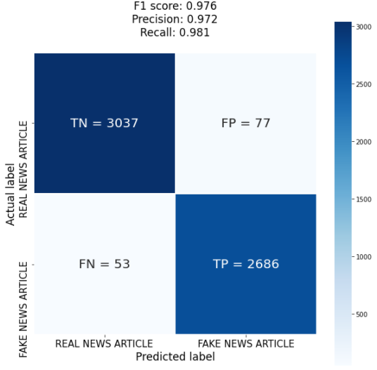
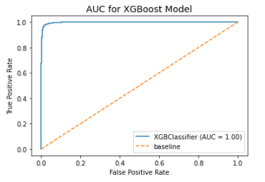
Conclusion
XG Boost Model using Count Vectorizer have the best performance.
Accurate classification ~ 97% of the time; 5,723 out of 5,853 predictions
AUC score ~ 1%

Slide 27
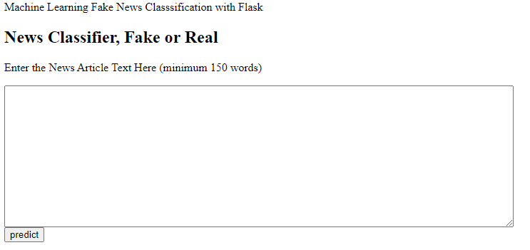
Model Demonstration
A simple flask app is created to demonstrate on how US citizens can use the model to differentiate between real or fake news, all by themselves.
Flask App Link

Slide 28
Recommendations
01
Deploy the model for use as a self fact-check system in testing with actual articles
Given the strong performance of model (97% accuracy score, 98% F1 score, ~1 AUC Score), US citizens can benefit from deploying the model for purpose of self fact-check of political news.
02
Retrain the model periodically with new political news articles.
As time passes, there would be a need to retrain the model with new and more relevant political news articles. This is to continuing to ensure that the model can continually maintained a high performance.
03
Explore the expansion of the model to cover other news area.
Currently, the model only includes news articles from politics. In the near future, it would be better if the model can expand to include fact-check of other areas: healthcare, education, sports, etc.

Slide 29
Thank You!
Do you have any questions?

